Slide 1
Fundamental of Programming

Slide 2
Repetition Structures (LOOPs)

Slide 3
(1) for loop
#include <iostream>
using namespace std;
int main()
{
int j;
for (j=0; j<10; j++)
cout << j * j <<endl;
return 0;
}

Slide 4
(1) for loop - Syntax
for (int j=0; j<10; j++)
cout << j * j <<endl;
Initialization
expression
Test Condition
Increment expression
cout << j*2 <<endl;
cout << j*j*j <<endl;

Slide 5
(for loop) -- Class Exercise-1
- Get a number form user and calculate its factorial

Slide 6
(for loop) -- Class Exercise-2
- Write a program that ask the user to enter a number. The program should print the Cube of all integers starting from 1 to the Number.
E.g.,
Enter a Number: 4
1 1
2 6
3 27
4 64

Slide 7
(for loop) -- Class Exercise-3
- Write a program that asks the user to enter two numbers: speed1, and speed2 representing speeds in KPH (Kilo meters per Hour). Then the program should convert and show table of speeds in MPH (Miles per Hour) for all the speed values between speed1 and speed2.
MPH = KPH * 0.6214
speed1 and speed2 variables should be multiple of 10. Each table entry (in KPH) should be updated by 5 in each iteration.

Slide 8
for loop – Multiple Expressions
for (int j=0, k=9; j<10; j++,k--)
cout << j * j <<endl;
cout<< k*k <<endl;
Multiple Initialization
expressions
Multiple Increment/Dec
expressions
Only one
Test Condition

Slide 9
(1) for loop - Variable Visibility
void main()
{
int j;
for(j=0; j<10; j++) {
int k=0;
k = j*j;
cout<<“\nValue of k: “<<k;
}
// k = 23; Cannot do this!
}

Slide 10
(1) for loop – optional expressions
int j=0;
for(; j<10; j++)
cout<<“\nHello world“;
int j=0;
for(; j<10;)
{
cout<<“\nHello world“;
j++;
}
for(; ;)
cout<<“\nHello world“;
Infinite loop
(it never terminates)

Slide 11
while loop
for loop does something a fixed number of times.
If you don’t know how many times you want to do something before you start the loop?
In this case a different kind of loop may be used: the while loop

Slide 12
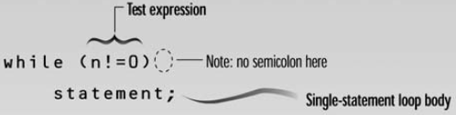
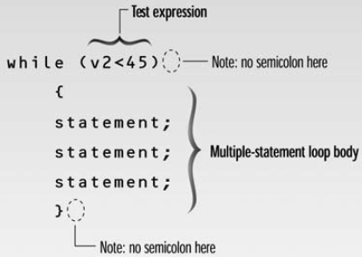
while loop - syntax
Loop body contain
single statement
Loop body contain
Multiple statement

Slide 13
Example: Tracing a while Loop
Initialize count
int count = 0;
while (count < 2)
{
cout << "Welcome to C++!";
count++;
}

Slide 14
Example: Tracing a while Loop
(count < 2) is true
int count = 0;
while (count < 2)
{
cout << "Welcome to C++!";
count++;
}

Slide 15
Example: Tracing a while Loop
int count = 0;
while (count < 2)
{
cout << "Welcome to C++!";
count++;
}
Print “Welcome to C++”

Slide 16
Example: Tracing a while Loop
int count = 0;
while (count < 2)
{
cout << "Welcome to C++!";
count++;
}
Increase count by 1
count is 1 now

Slide 17
Example: Tracing a while Loop
(count < 2) is still true since count is 1
int count = 0;
while (count < 2)
{
cout << "Welcome to C++!";
count++;
}

Slide 18
Example: Tracing a while Loop
int count = 0;
while (count < 2)
{
cout << "Welcome to C++!";
count++;
}
Print “Welcome to C++”

Slide 19
Example: Tracing a while Loop
int count = 0;
while (count < 2)
{
cout << "Welcome to C++!";
count++;
}
Increase count by 1
count is 2 now

Slide 20
Example: Tracing a while Loop
(count < 2) is false since count is 2 now
int count = 0;
while (count < 2)
{
cout << "Welcome to C++!";
count++;
}

Slide 21
Example: Tracing a while Loop
int count = 0;
while (count < 2)
{
cout << "Welcome to C++!";
count++;
}
The loop exits. Execute the next statement after the loop.

Slide 22
Example Program
Write a program to print character entered by user, terminate the program when ‘z’ is pressed.
#include <iostream>
#include <conio.h>
using namespace std;
void main( )
{
char ch='0';
cout<<"Enter characters, z to terminate..\n";
while(ch!='z')
ch = _getche();
cout<<“Program ended…”
}

Slide 23
(while loop) -- Class Exercise-1
Write a program to get characters from the user. In the end of the program should count total characters (entered by the user). The program should stop taking input when 0 is pressed.

Slide 24
(while loop) -- Class Exercise-2
Write a program to get input in the form of characters from the user. In the end of the program should count total words entered by the user. The program should stop taking input when 1 is pressed.

Slide 25
(while loop) -- Class Exercise-3
Write a program that inputs a value in an integer number from user. For this number the program returns the count for how many times can we divide this number by 2 to get down to 1”.
int count = 0; int num; cin>>num;
//count how many divisions we've done
while (num >= 1)
{
num = num / 2;
count++;
}
cout<<“\nWe have to divide: “<<count<<“ times”;

Slide 26
do loop
In while loop if condition is false it is never entered or executed
Sometime, requirements are that the loop should be executed at least once….
For that, we use do loop, that guarantees at least on execution of the loop body

Slide 27
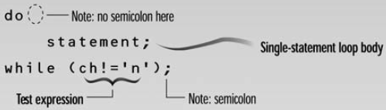
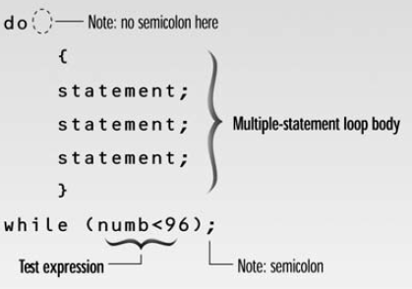
do while loop - syntax
Loop body contain
single statement
Loop body contain
Multiple statement

Slide 28
do loop – Example1
#include <iostream>
using namespace std;
void main( )
{ int counter, howmuch; cin>>howmuch; counter = 0;
do {
counter++;
cout<<counter<<'\n';
} while ( counter < howmuch);
}

Slide 29
do loop – Example2
void main( )
{ int num1, num2; char choice; do {
cout<<“\nEnter a number:”;
cin>>num1;
cout<<“\nEnter another number:”;
cin>>num2;
cout<<“\nTheir sum is: “<<num1+num2;
cout<<“\nDo another time (y/n):”;
ch = _getche(); // #include <conio.h>
} while(ch==‘y’);
}

Slide 30
“break” Statement
break statement
Immediate exit from while, for, do/while, (also used in switch)
Program continues with first statement after the loop structure
Common uses of break in Loop
Escape early from a loop OR skip remainder part of the loop

Slide 31
“break” Statement Syntax
for (int i=1; i<=5; i++)
{
if (i==3)
break;
cout<<“Hello”;
}
===================================================
int n;
int EvenSum=0;
while(1)
{
cin>>n;
if(n%2==1)
break;
EvenSum = EvenSum + n;
}

Slide 32
(using break in loops) – Class Exercise 1
Write a program which reads an integer n from the user, and prints square value (n*n) for that number. Whenever ZERO is entered by the user program should terminate by printing “Invalid Value” message.

Slide 33
break in loop – Concusion
“break” immediately ends the loop that contains it.

Slide 34
Nested Repetition Structures (Nested Loops)
In a nested repetition structure, one loop (inner loop) is placed entirely within another loop (outer loop)
In nested loops any loop (for, while, or do loop) can be placed inside another loop which can be a for, while, or a do loop

Slide 35
Nested Repetition Structures (Nested Loops) - Example
for (int i=0; i<2; i++)
{
for (int j=0; j<2;j++)
{
cout<<“\nHello-”<<i<<“:“<<j;
}
}
Outer Loop
Inner Loop

Slide 36
(Nested Loops) – Example Program-1
Write a program to print triangle of starts.
*
**
***
****
*****
******
*******
********
*********

Slide 37
(Nested Loops) – Example Program-2
Write a program to print triangle of starts.
*********
********
*******
******
*****
****
***
**
*

Slide 38
(Nested Loops) – Example Program-3
Write a program to print Rectangle based on two triangles (One using + and other using * symbol).
+********
++*******
+++******
++++*****
+++++****
++++++***
+++++++**
++++++++*
+++++++++

Slide 39
(Nested Loops) – Example Program-4
Write a program for a company to calculate total sales for 3 regions. Each region’s sales is entered by user which is then summed in total regional sales. The program keep accepting regional sales until it is not 0. The program prints the final regional sum for three regions and exits.
Example Output:
Total Sales for Region 1: 87645
Total Sales for Region 2: 2312
Total Sales for Region 3: 8874

